Slide 1


Python Webapp Programming
Questionnaire app with Django
--Templates, Admin Static files

Slide 2
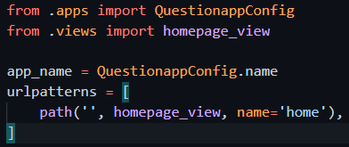
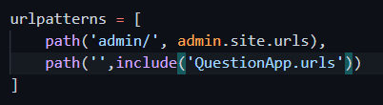
Config the URL to add our first page
Create urls.py in QuestionApp directory: (the following example is with powershell)
Add content to FirstApp/urls.py:
Modify QuestionPrj/urls.py:
PS> ni urls.py

Slide 3
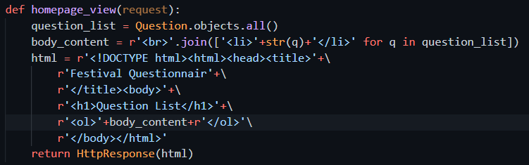
Add the homepage_view function
Modify the QuestionApp/views.py:
Add a new function homepage_view, which takes an HttpRequest object as arguments, return one HttpResponse.
The content of the response: extract from list of all questions.

Slide 4
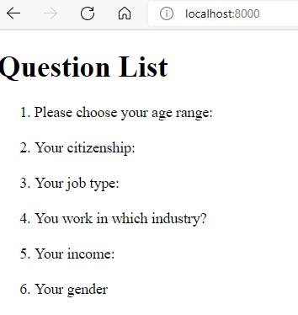
Check your homepage with browser
Use admin page to add some questions. Then from your browser visit
PS> cd QuestionPrj
PS> %virtual_env_directory%/Scripts/activate.ps1
(QuestionPrj) PS> py manage.py runserver
http://localhost:8000/

Slide 5
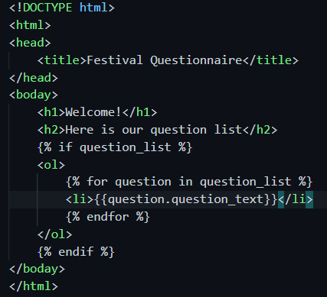
Template: a better way to make the return content
PS> cd QuestionApp
PS> ni templates –Type Directory
PS> cd templates
PS> ni QuestionApp –Type Directory
Ps> cd QuestionApp
PS> ni home.html
Create the template file:
QuestionApp/templates/QuestionApp/home.html
Add those content to the created home.html:

Slide 6
Django template language
{{ variable }}, {{ attribute }}
to evaluate the value of a variable or get value of attribute
{{ my_str|escape|linebreaks }}, {{ name|lower }}, {{ list|join:’, ’}}, {{ word|truncatewords:20 }}, {{ value|default:’nothing’ }}, {{ value|length }}
Filters ‘|’ – to do process of contents.
Can be chained.
If the filter function takes additional parameters use ‘:’
{% for …. in …. %} {% endfor %}
{% if …. %} {% elif …. %} {% else %} {% endif %}
Like flow control in python.
{# …… #}
Comment
{% block … %} {% endblock %}, {% extends …. %}
Inheritance: base template define the HTML structure, and use ‘block’ to define place holder.
The inherited template use ‘extends’ to specify base, and ‘block’ to define contents for the respective block

Slide 7
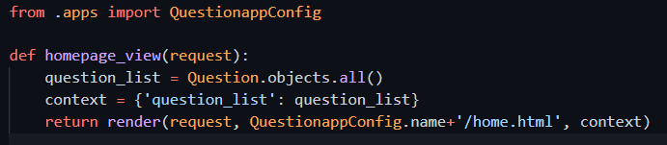
Change view to use the template
Modify QuestionApp/views.py:
context:
It is a dict.
The keys of the dict are names inside templates.
The values are variables/objects.
The Django template has special syntax to render the actual variables/objects value according to names
Check it with your browser
(QuestionPrj) PS> py manage.py runserver
This is a mature style to create views and using models and templates.

Slide 8
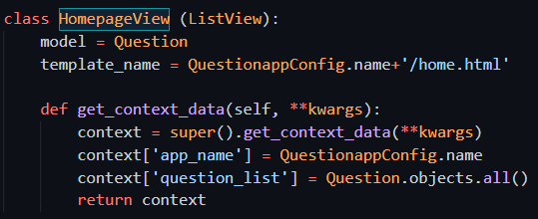

Using Django ready made view classes
Django has many ready-made views we can use, to simplify our coding work.
Modify QuestionApp/views.py
Modify QuestionApp/urls.py
Check it with your browser
(QuestionPrj) PS> py manage.py runserver
This is now the most frequently used ways to create views.

Slide 9
Modify home template to add link
In template, the function url will use the “name” property defined in urls.py, to reverse map to a actual URL which can be used in client HTTP request.
Notice the name defined in QuestionApp/urls.py, need to append with app_name if we define it. for example the ‘home’, should be using url ‘QuestionApp:home’ in template to reverse and get real URL. (if did not define the app_name in urls.py, then no need to add it)
When there are some parameter in the url config, then the reverse url will also need additional parameter
In QuestionApp/urls.py
In QuestionApp/templates/QuestionApp/home.html

Slide 10
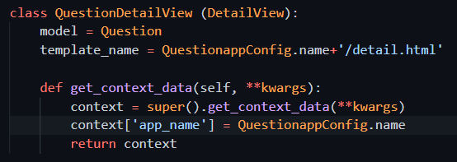
Add new template/view for detail
We already added the question_detail url config in urls.py
Now need add template and view:
Add a new view in QuestionApp/views.py

Slide 11
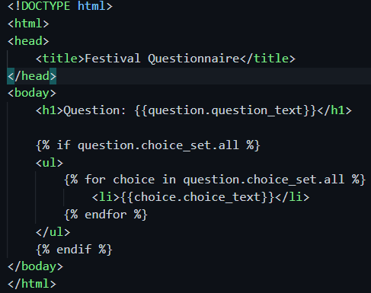
Add new template/view for detail
We already added the question_detail url config in urls.py
Now need add template and view:
Add a new file QuestionApp/templates/QuestionApp/detail.html

Slide 12
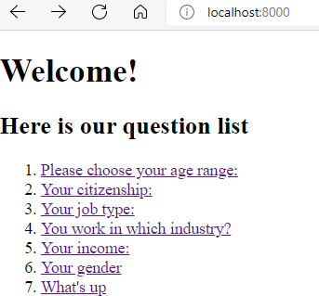
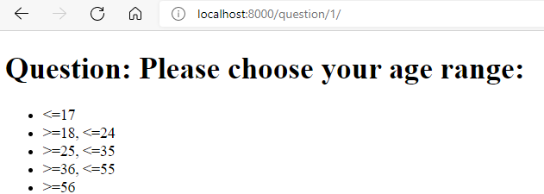
Check the app with your browser
Runserver and use browser to visit http://localhost:8000/
(QuestionPrj) PS> py manage.py runserver

Slide 13
Optimize the templates: use extends
Different templates files can have a hierarchical structure. You can define a common base.html as structure, and then extend from it to add different templates with the different content
{%extends%} work with {%block%} together. Base template file can have empty {%block%}, and those templates which extends define the real content of {%block%} to replace in.
base.html
extends
home.html
detail.html

Slide 14
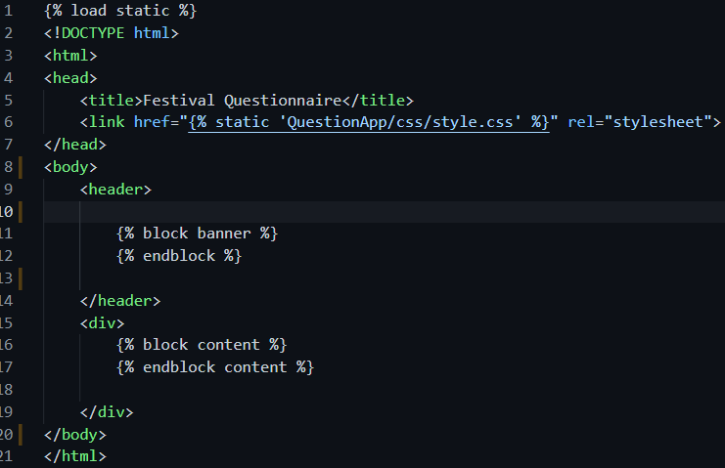
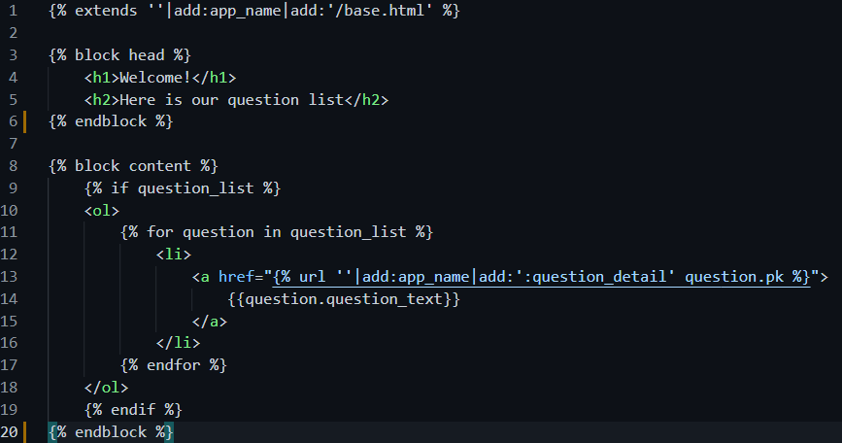
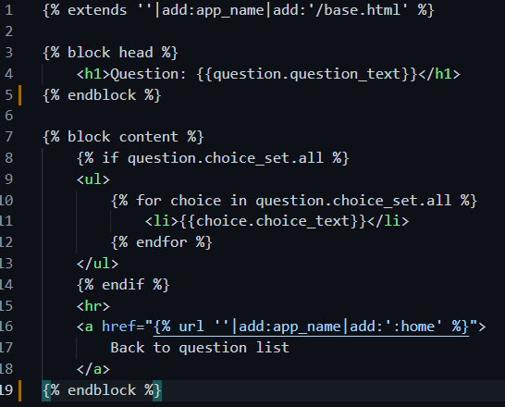
Optimize the templates: use extends
base.html
home.html
detail.html

Slide 15
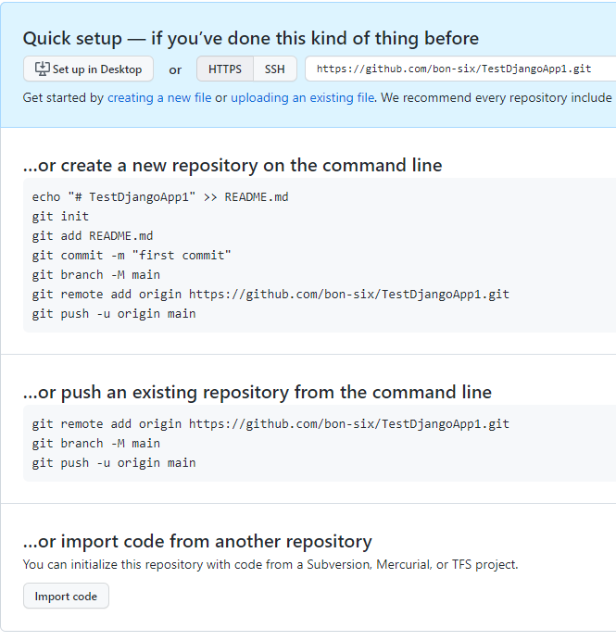
Create local repo. Push to remote repo.
Create a new repo in github website.
The second option to push your code to git repo.
May need authenticate the account with a newly opened browser window when execute the command
Create empty remote repo
PS> cd QuestionPrj
PS> git init
PS> git add –A
PS> git commit –m “initial commit”
Create and commit local repo
PS> git remote add origin XXXXXXXX
PS> git branch –M main
PS> git push –u origin main
Push local to remote

Slide 16
Prepare for Heroku deployment
Create one file: 2myprj/QuestionPrj/Procfile
Add one line code to Procfile:
Update myproject/FirstPrj/FirstPrj/setting.py code, allow all hosts access.
Use pipenv shell to install gunicorn:
PS> pipenv install gunicorn

Slide 17
Prepare for Heroku deployment
Update your change to remote repo.
PS> cd QuestionPrj
PS> git status
PS> git add –A
PS> git commit –m “update for deploy to Heroku”
PS> git push –u origin main

Slide 18
Use Heroku cli to deploy app to cloud
Download and install Heroku cli application
At pipenv shell, can type Heroku login, to login your account just created. It will open a browser window to authenticate.
Replace with your own app name which given back by the create command
PS> heroku login
PS> heroku create
PS> heroku git:remote –a pacific-cove-21952
PS> heroku config:set DISABLE_COLLECTSTATIC=1
PS> git push heroku main
PS> heroku ps:scale web=1
Not deploy static and we try our app
This will push the code to be deployed to Heroku.
No need subtree push as out git folder is also django project folder
[If your Heroku app has previously deployed content and you want clear it, here is the command]
PS> heroku plugins:install Heroku-repo
PS> heroku repo:reset –a %your-app_name%

Slide 19
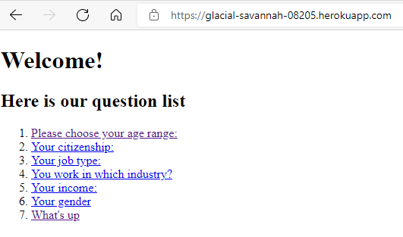
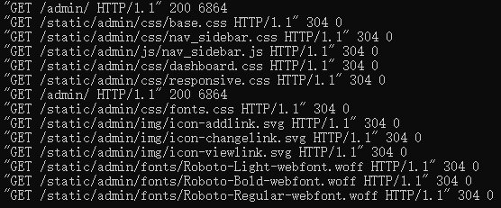
Now visit your cloud webpage
Our Question app deploy looks ok.
However, the admin app looks not good, due to css styling and pictures not properly handled.

Slide 20

Deploy static files
Those files belong to admin app are called static files. (they are not dynamically changing, always same for each client come to visit.)
add whitenoise to support static files distribution for the heroku gunicorn production server. Remember to copy the change Pipfile and Pipfile.lock
Changes in QuestionPrj/setting.py
Create the directory which used for static files
PS> cd QuestinoPrj
PS> pipenv install whitenoise
PS> cd QuestionPrj
PS> ni –Type Directory static
PS> cd static
PS> ni README
Create an empty file, in order git keep the directory (git repo do not keep empty directory)

Slide 21
Deploy static files
PS> cd QuestionPrj
PS> git status
PS> git add –A
PS> git commit –m “add static files deploy”
PS> git push origin main
We need set this to 0 as now we are trying to include static files in our site.
If for a project from beginning you did not set it to 1, can skip this
PS> heroku config:set DISABLE_COLLECTSTATIC=0
PS> git push heroku main
PS> heroku ps:scale web=1

Slide 22
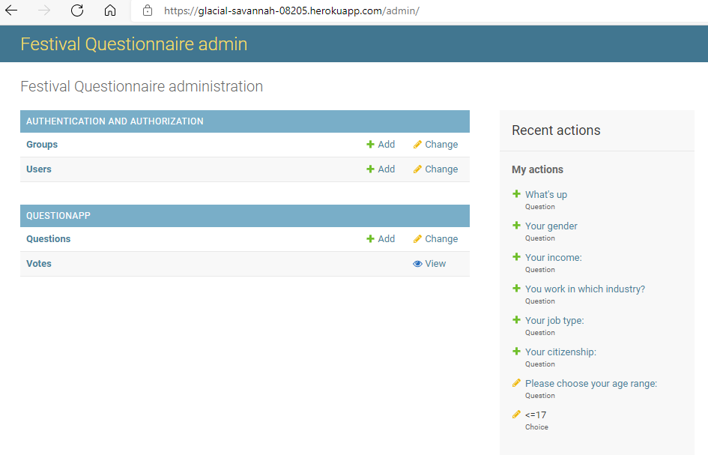
Check the admin with your browser

